Slide 1

InSAR-BASED LANDSLIDE MOVEMENT MODELS: A CASE STUDY OF JIZAN PROVINCE, SAUDI ARABIA
Roman Shults

Slide 2
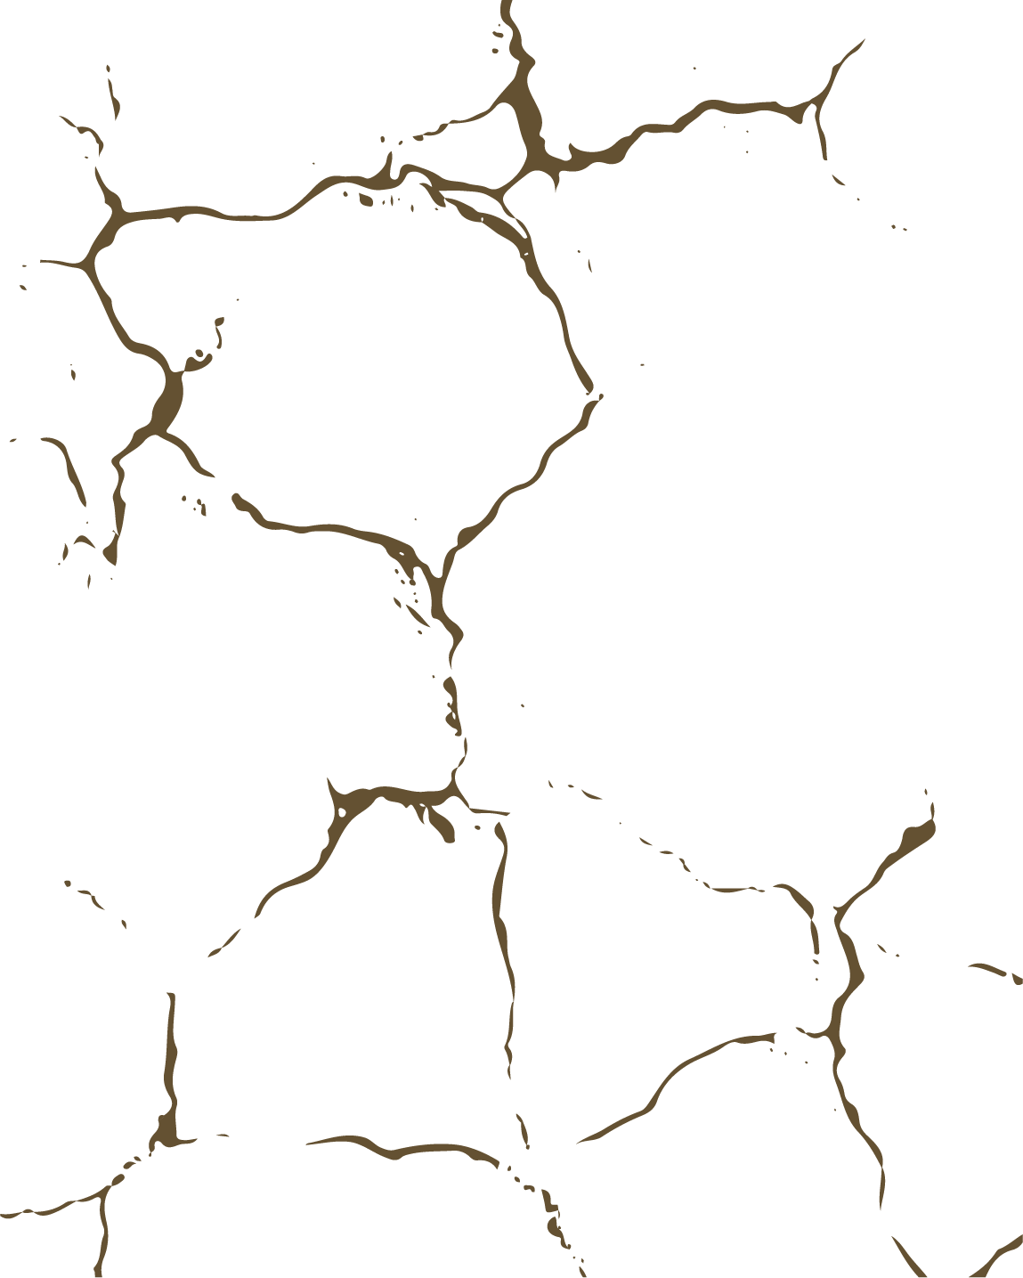
Content
STUDY OBJECT
MONITORING TECHNOLOGY
DATA
GROUP METHOD OF DATA HANDLING
SIMULATION
CONCLUSIONS

Slide 3
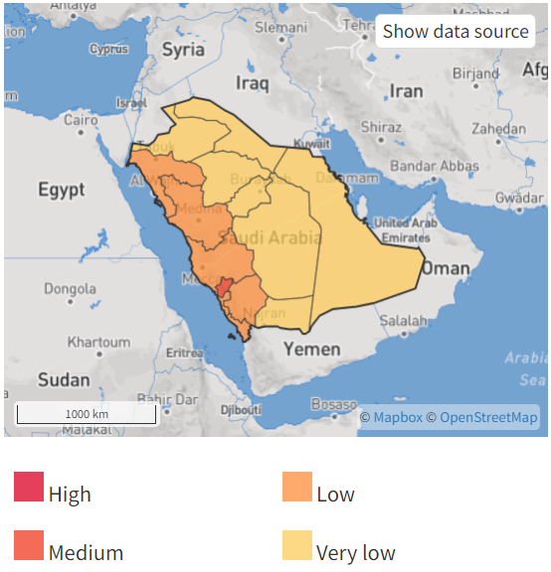
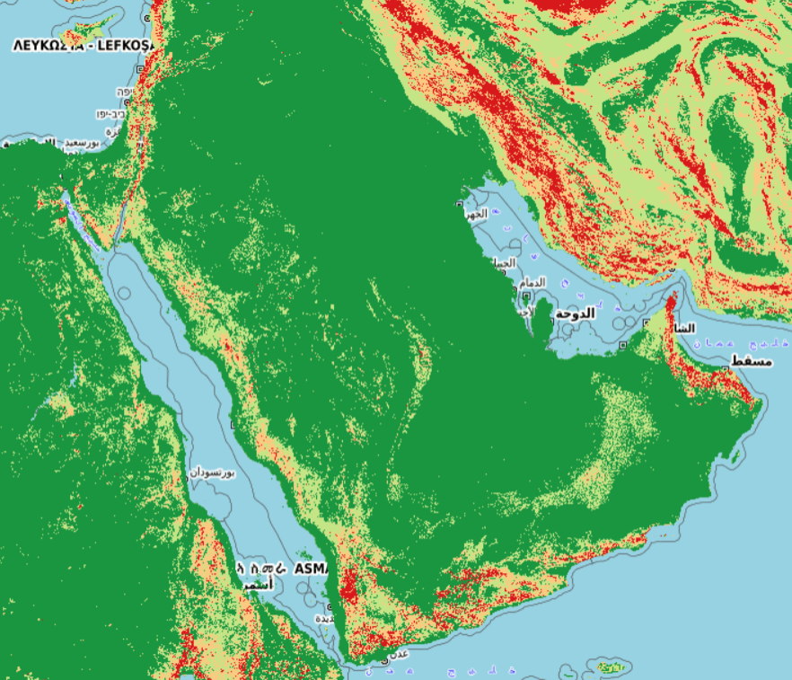
Study object
The regions of the Kingdom that are susceptible to landslide phenomena

Slide 4
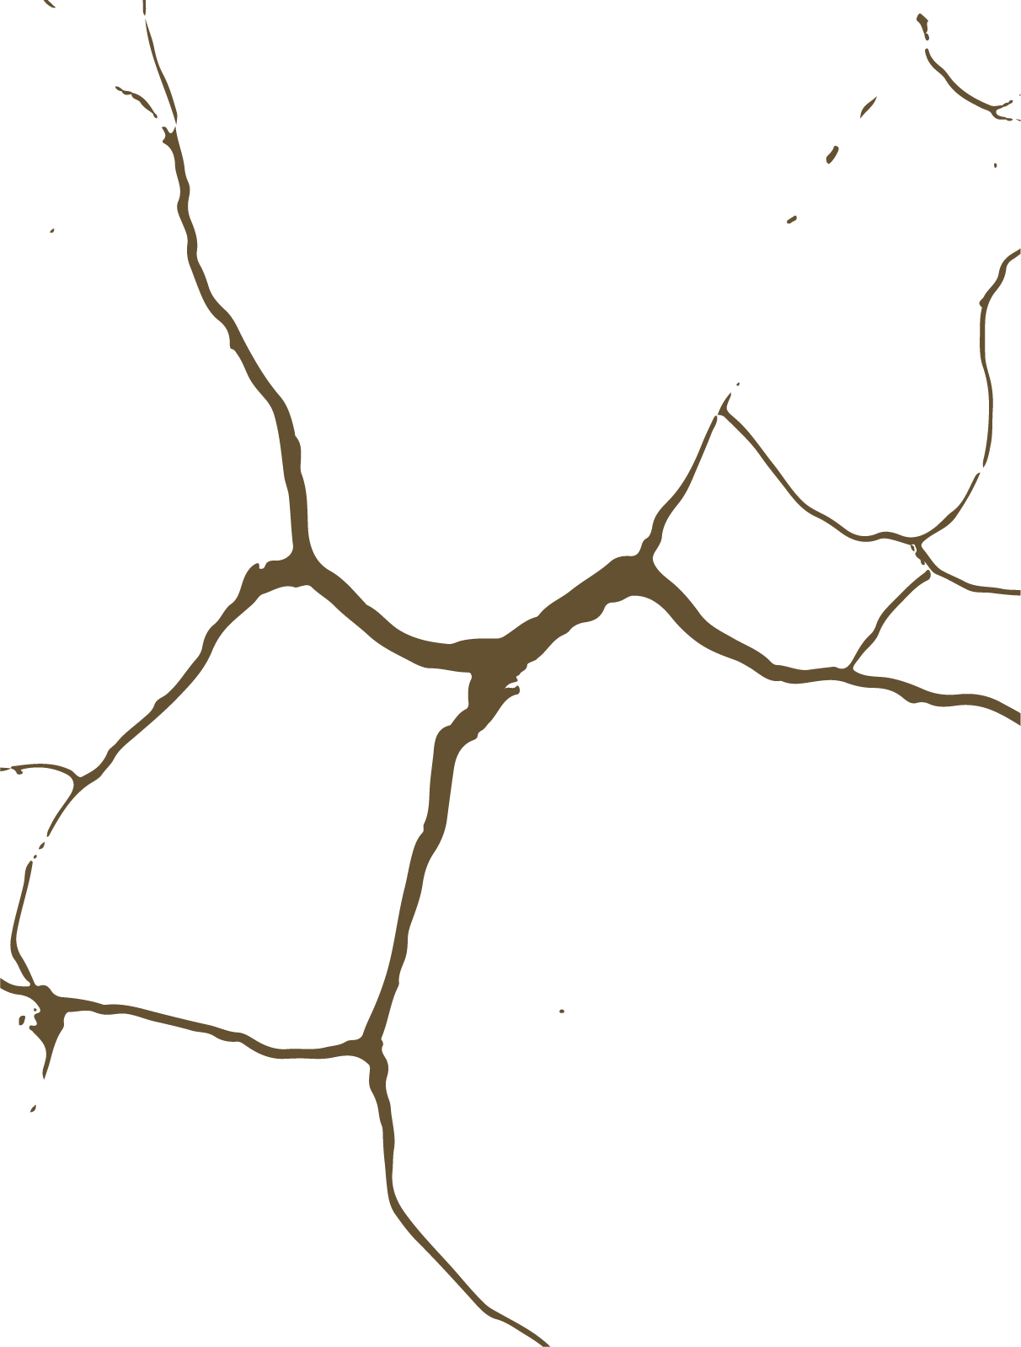
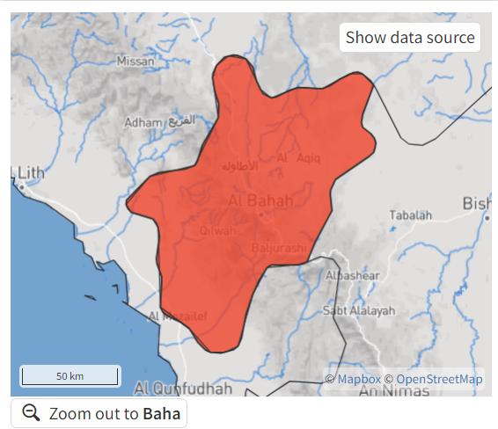

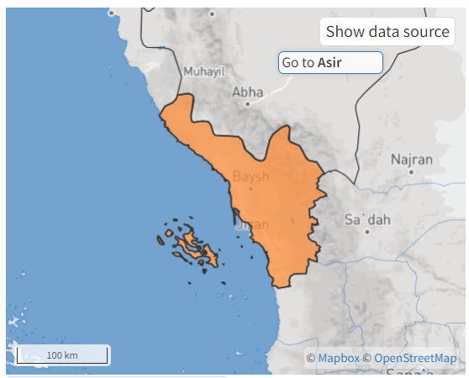
Study object

Slide 5

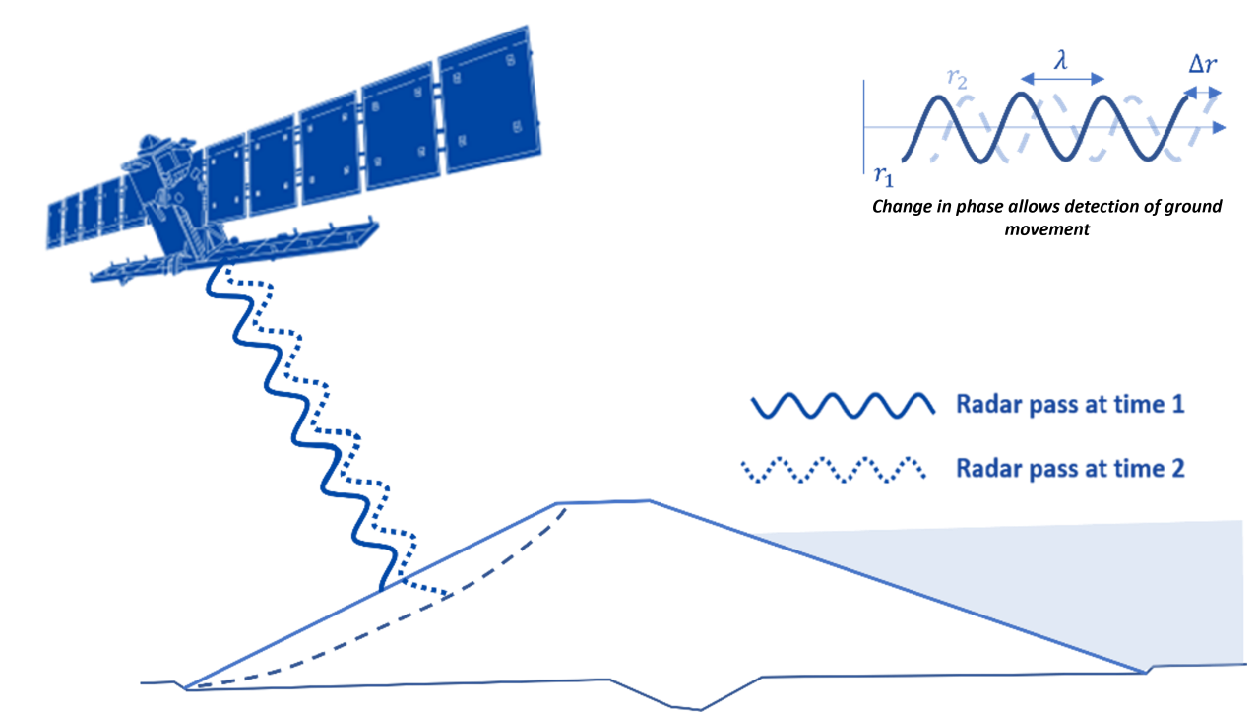
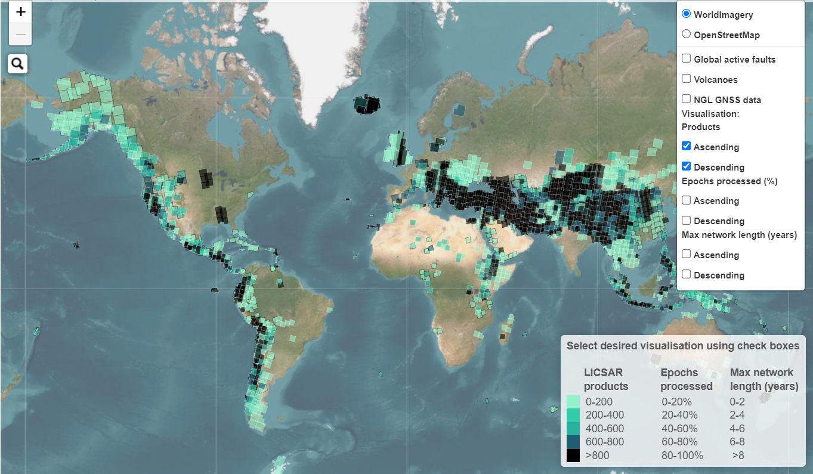
Monitoring technology (InSAR)

Slide 6
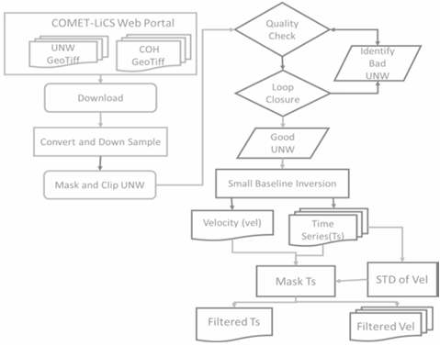
Monitoring technology (InSAR)

Slide 7
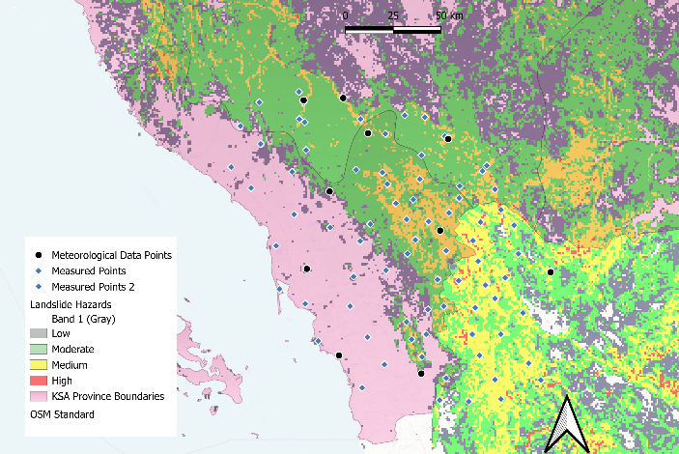
Data

Slide 8
Data
Notes:
Humidity
Temperature
Wind speed
Cumulative precipitation

Slide 9
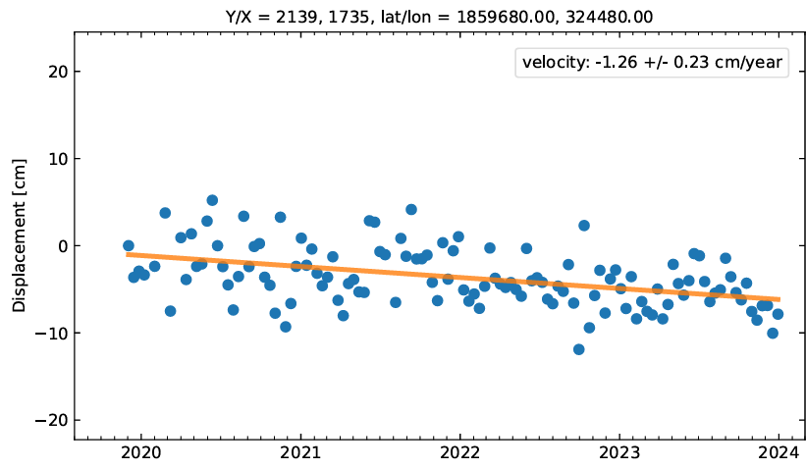
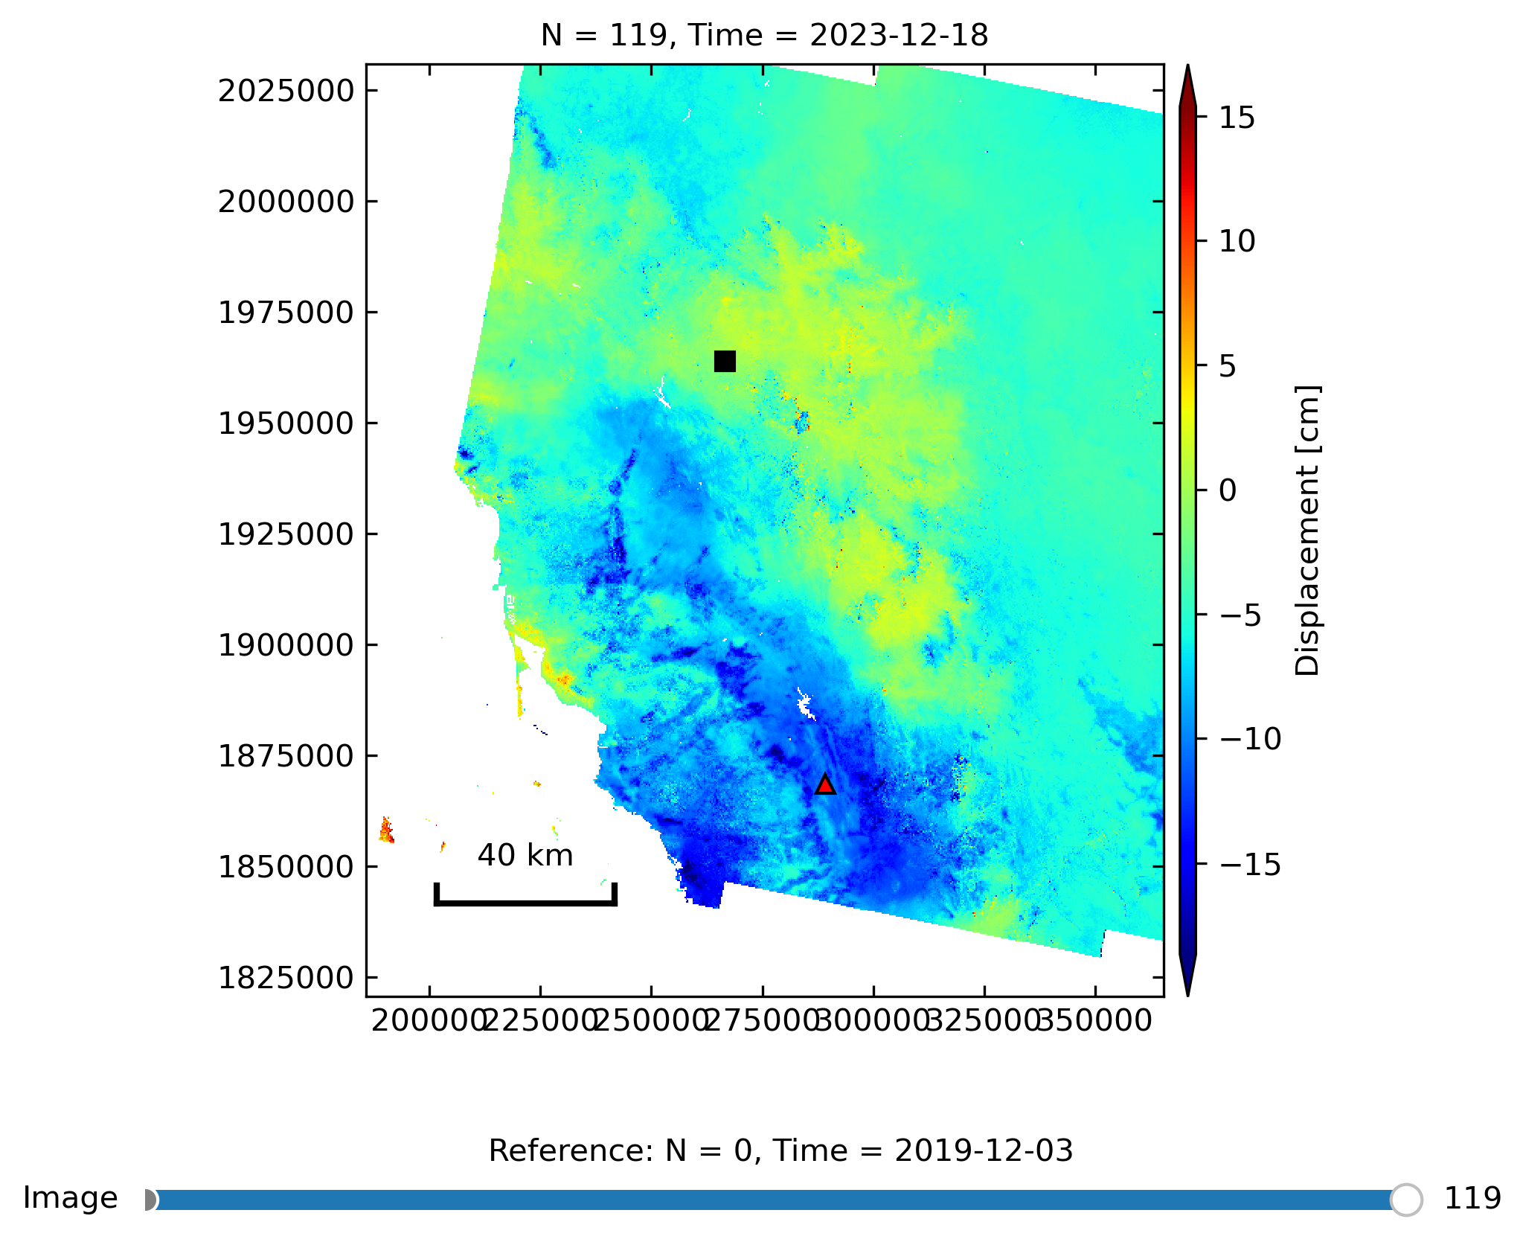
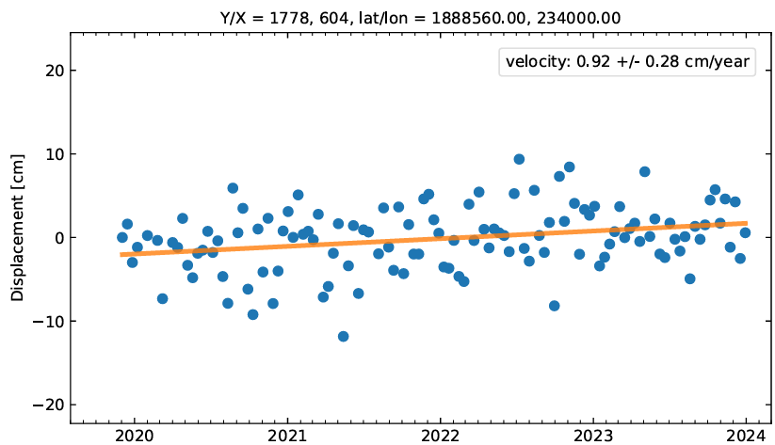
Data

Slide 10
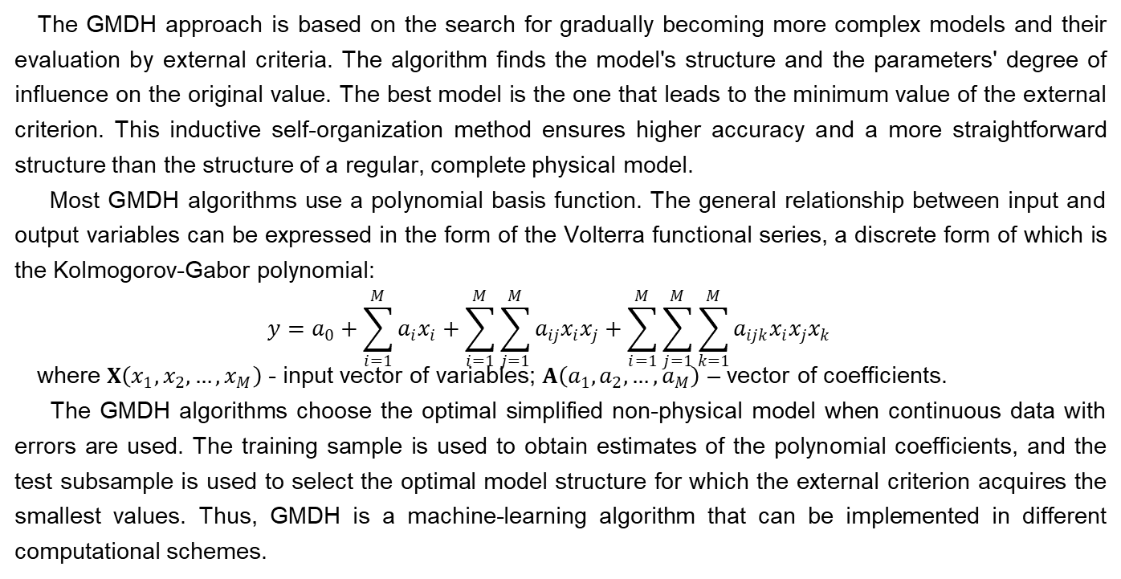
Group method of data handling
The GMDH approach is based on the search for gradually becoming more complex models and their evaluation by external criteria. The algorithm finds the model's structure and the parameters' degree of influence on the original value. The best model is the one that leads to the minimum value of the external criterion. This inductive self-organization method ensures higher accuracy and a more straightforward structure than the structure of a regular, complete physical model.
Most GMDH algorithms use a polynomial basis function. The general relationship between input and output variables can be expressed in the form of the Volterra functional series, a discrete form of which is the Kolmogorov-Gabor polynomial:
$$y=a_{0}+\sum_{i=1}^{M}{a_{i}x_{i}}+\sum_{i=1}^{M}{\sum_{j=1}^{M}{a_{ij}x_{i}x_{j}}}+\sum_{i=1}^{M}{\sum_{j=1}^{M}{\sum_{k=1}^{M}{a_{ijk}x_{i}{x_{j}x}_{k}}}}$$
where $X\left(x_{1},x_{2},…,x_{M}\right)$ - input vector of variables; $A\left(a_{1},a_{2},…,a_{M}\right)$ – vector of coefficients.
The GMDH algorithms choose the optimal simplified non-physical model when continuous data with errors are used. The training sample is used to obtain estimates of the polynomial coefficients, and the test subsample is used to select the optimal model structure for which the external criterion acquires the smallest values. Thus, GMDH is a machine-learning algorithm that can be implemented in different computational schemes.

Slide 11
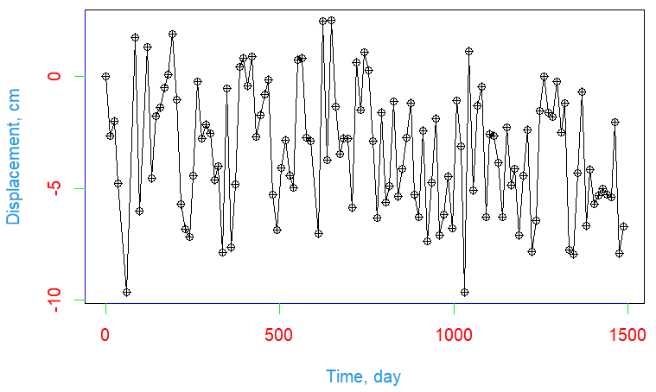
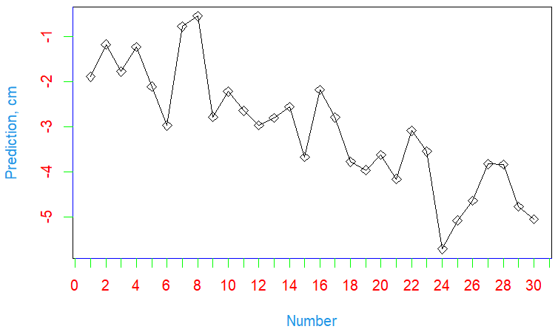
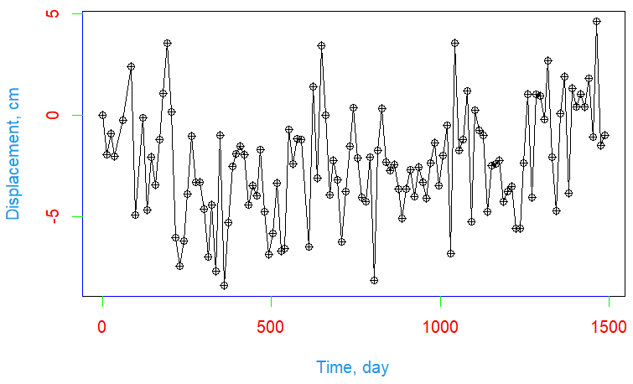
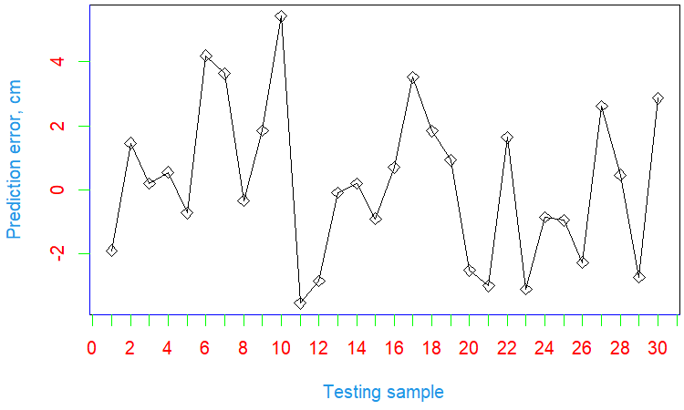
Simulation
Notes:
R GMDH packages
Prediction results for the testing sample point 28, GMDH Combinatorial
Prediction errors for the testing sample point 28, GMDH Combinatorial

Slide 12
Conclusions
The presented study demonstrated the high efficiency of state-of-the-art remote sensing technologies for landslide monitoring problems.
The results showed that more data and parameters are necessary for precise prediction. Our dataset was limited to meteorological data. Therefore, our findings are not generalizable to landslide prediction models in general.
Future research will have to explore the impact of groundwater levels, earthquakes, and variations in a gravity field.
In building prediction models, we must keep human activity in mind (construction works, mining, etc.). Nonetheless, machine learning algorithms such as GMDH proved their performance. The more data we upload to a machine learning algorithm, the more adequate model we will obtain.

